Slide 1
Prime Number Generation and Testing
Hallee Pham
University of Missouri – Kansas City
Spring 2024

Slide 2
Introduction
01
Overview
Importance
This project aims to explore various algorithms for generating prime numbers and testing whether a given number is prime
Prime numbers are fundamental in various fields, including cryptography, mathematics, and computer science. Understanding efficient algorithms for generating and testing prime numbers has practical implications in these industries.

Slide 3
Objective and Goals
Implement two prime generation algorithms (Sieve of Eratosthenes & Sieve of Atkin).
Implement two prime testing algorithms (Fermat’s Primality Test & Rabin-Miller Primality Test).
Measure the execution time of the prime generation and testing algorithms using random test cases.
Analyze the time complexity of the algorithms.
Visualize the data to demonstrate performance differences.

Slide 4
Problem Statement
02
Problem Statement
The problem involves finding efficient algorithms for generating prime numbers and determining whether a given number is prime
Why is this important to address?
Prime numbers are widely used in security/encryption techniques due to some of its fundamental properties:
- It is very fast to multiply two prime numbers
- However, it is very difficult to factor the product back into the original prime numbers
Let's look at an example…

Slide 5
Example
03
Lets choose two small prime numbers:
a = 13 and b = 17
Now lets compute their product:
a x b = 13 x 17 = 221
In order for the computer to factor this result, it would have to check all possible factors
Check if 2 is a factor of 221
Check if 3 is a factor of 221
Check if 5 is a factor or 221
And so on…

Slide 6
Example (continued)
This may look relatively simple, but as the numbers get larger, the search space grows exponentially, making it very time-consuming and difficult
This is why prime numbers are used in public key encryption

Slide 7


2⁸²⁵⁸⁹³³ -1
The largest known prime number is:
This number has more than 24 million digits!
500
Factoring a digit number into its primes could take as long
as a planet’s formation! (Maier, 2021)
https://www.livescience.com/physics-mathematics/mathematics/what-is-the-largest-known-prime-number

Slide 8
Methodology
04
1. Research Phase
Research on the importance of prime numbers in the technology field through simple search engines.
Prompts were along the lines of “What is the importance of prime numbers in computer science?”
Research done on the different prime number generation and testing algorithms
Select which ones I wanted to research
Understand the steps of each algorithm
General time/space complexities
Narrow down the best implementations for each algorithm

Slide 9
Methodology (Continued)
2. Algorithm Implementation Phase
Translate theoretical concepts learned from the research phase into executable code
Programs were coded in Python on Replit compiler
Code was sourced from GeeksForGeeks with modifications to support a timer and random test cases
3. Generating Random Test Cases Phase
Used the randtint() method in the random module of Python
Method takes in two integers representing the lower and upper bounds
Will be used in the testing process to test efficiency of algorithms according to an increasing number of digits

Slide 10
Methodology (Continued)
4. Testing Phase
Timers were integrated into code to record their execution times
Isolate the running of just the function
Three different tests with ten trials each
Numbers with 2 digits, 4 digits, and 6 digits
After each algorithm is finished running, the total run time is printed and recorded into a data table for later analysis

Slide 11
Implementations (Generating Algorithms)
05
1. Prime Number Generating Algorithms
Given an input n, prints out all prime numbers less than or equal to n
The Sieve of Eratosthenes
The Sieve of Atkin
Sieve: “A simple method for finding prime numbers”

Slide 12
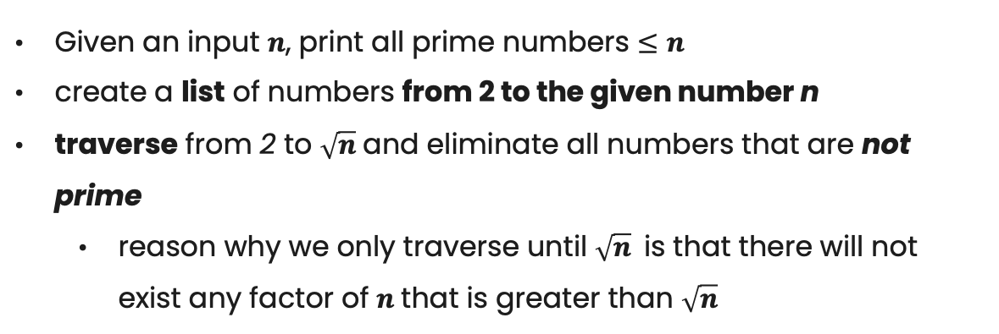
The Sieve of Eratosthenes
An ancient method introduced by Greek mathematician Eratosthenes in the third century B.C. (Kaur, 2021)
General Concept
Given an input $n$, print all prime numbers $≤n$
create a list of numbers from 2 to the given number n
traverse from 2 to $\sqrt{n}$and eliminate all numbers that are not prime
reason why we only traverse until $\sqrt{n}$is that there will not exist any factor of $n$that is greater than $\sqrt{n}$

Slide 13
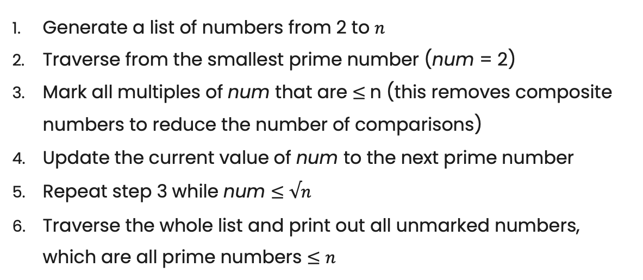
The Sieve of Eratosthenes (continued)
Steps
Generate a list of numbers from 2 to $n$
Traverse from the smallest prime number (num = 2)
Mark all multiples of num that are $≤$n (this removes composite numbers to reduce the number of comparisons)
Update the current value of num to the next prime number
Repeat step 3 while num $≤$ $√n$
Traverse the whole list and print out all unmarked numbers, which are all prime numbers $≤n$
These steps are a modified version from GeeksforGeeks:
https://www.geeksforgeeks.org/sieve-of-eratosthenes/

Slide 14
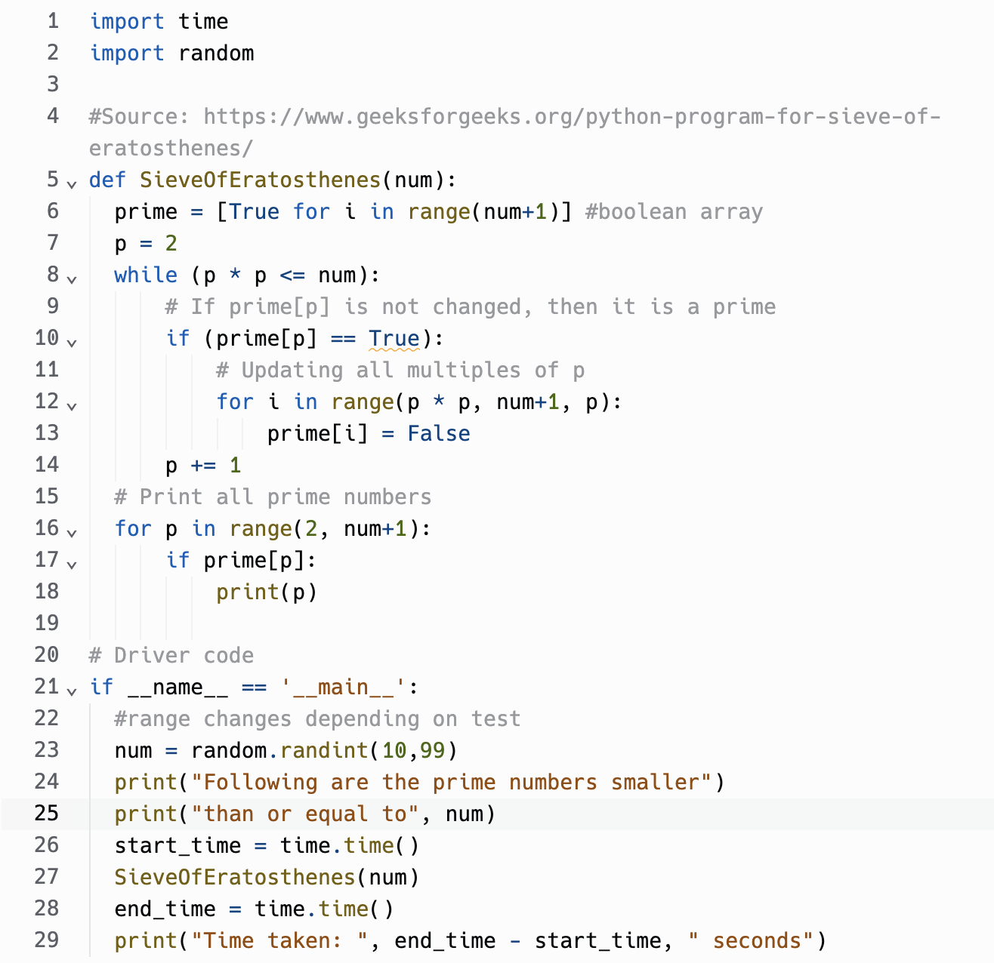
The Sieve of Eratosthenes (code)
This code is a modified version from GeeksforGeeks:
https://www.geeksforgeeks.org/sieve-of-eratosthenes/

Slide 15

The Sieve of Eratosthenes (code)
By analyzing the number of primitive operations, the estimated time complexity is $Ο(nlog\left(logn\right))$

Slide 16
The Sieve of Atkin
This method is similar to the Sieve of Eratosthenes, however, it does preliminary work before traversing through the list of numbers and marks off the multiples of squares of primes, instead of just the multiple of primes
General Concept
Two lists are created, a results list and a sieve list
This method uses different properties of primes to filter out prime numbers (shown in the next slide)
When a number in the sieve list is marked as prime, it is moved to the results list.

Slide 17
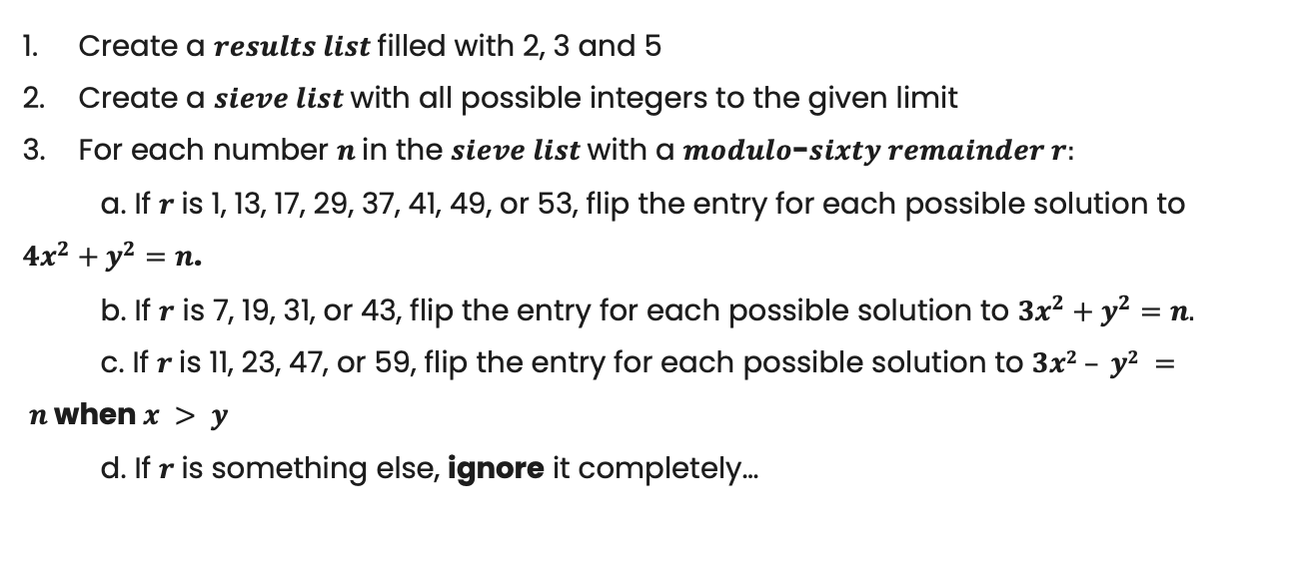
The Sieve of Atkin (continued)
Steps
Create a $results list$ filled with 2, 3 and 5
Create a $sieve list$ with all possible integers to the given limit
For each number $n$in the $sieve list$ with a $modulo$-$sixty remainder r:$
a. If $r$is 1, 13, 17, 29, 37, 41, 49, or 53, flip the entry for each possible solution to $4x^{2}+y^{2}=n$.
b. If $r$ is 7, 19, 31, or 43, flip the entry for each possible solution to $3x^{2}+y^{2}=n.$
c. If $r$is 11, 23, 47, or 59, flip the entry for each possible solution to $3x2 – y2 = n$when $x > y$
d. If $r$is something else, ignore it completely…

Slide 18
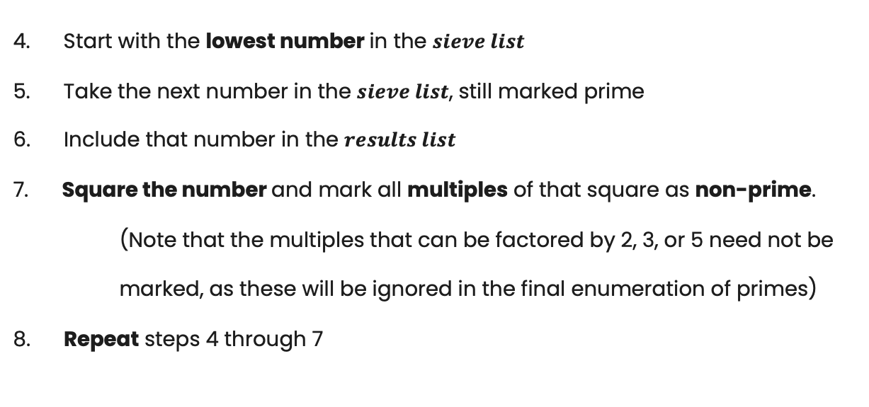
The Sieve of Atkin (continued)
Steps (continued)
4. Start with the lowest number in the $sieve list$
5. Take the next number in the $sieve list$, still marked prime
6. Include that number in the $results list$
7. Square the number and mark all multiples of that square as non-prime. (Note that the multiples that can be factored by 2, 3, or 5 need not be marked, as these will be ignored in the final enumeration of primes)
8. Repeat steps 4 through 7

Slide 19
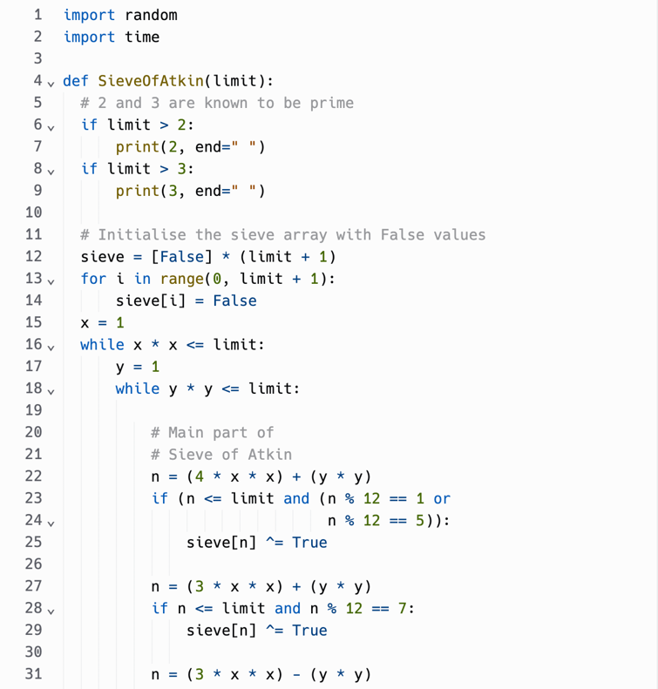
The Sieve of Atkin (code)
This code is a modified version from GeeksforGeeks:
https://www.geeksforgeeks.org/sieve-of-atkin/

Slide 20
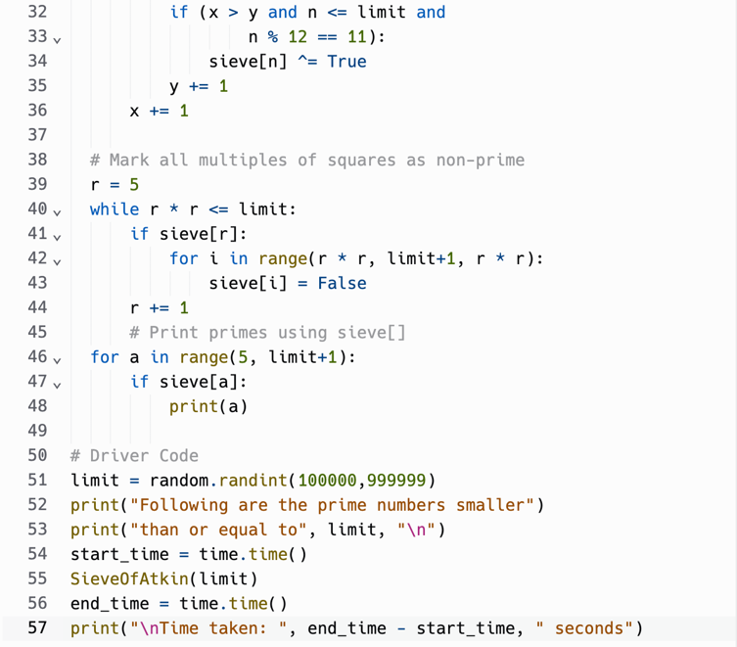
The Sieve of Atkin (code)
By analyzing the number of primitive operations, the estimated time complexity is $Ο(n)$

Slide 21
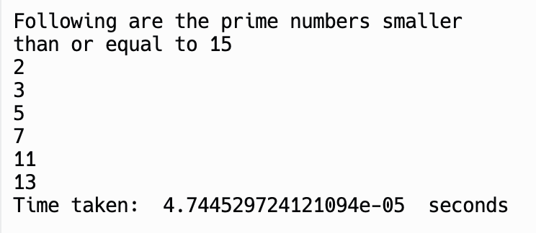
Data Collection (Generating Algorithms)
06
Test Cases: Three sets of test cases were generated to evaluate the performance of the prime generation and testing algorithms.
Test 1: Random inputs with 2 digits (10 to 99 inclusive)
Test 2: Random inputs with 4 digits (1,000 to 9.999 inclusive)
Test 3: Random inputs with 6 digits (100,000 to 999,999 inclusive)
Trials: Each test consisted of 10 trials, ensuring consistency and reliability in the data collection process.
Example Run:

Slide 22
Sieve of Eratosthenes
Trial Number | 2 digits (μs) | 4 digits (μs) | 6 digits (μs)
1 | 257.0 | 10277.7 | 5663437
2 | 468.3 | 23623.9 | 5373438
3 | 283.7 | 8996.5 | 638054
4 | 125.2 | 24919.0 | 2387793
5 6 7 8 9 | 216.5 223.4 7668.5 127.1 111.3 | 10999.0 7031.0 16903.6 10189.1 5679.4 | 1120843 5737152 4026678 3667132 5987158
10 | 418.7 | 22745.4 | 2877832
Average | 989.97 | 14136.46 | 3747951.7

Slide 23
Sieve of Atkin
Trial Number | 2 digits (μs) | 4 digits (μs) | 6 digits (μs)
1 | 55.7 | 101353.9 | 10011654
2 | 284.7 | 27794.4 | 2525876
3 | 426.5 | 18753.5 | 7211703
4 | 193.6 | 3447.5 | 6171796
5 6 7 8 9 | 139.7 721.2 82.3 1075.0 162.4 | 24867.3 59017.7 7260.8 78552.5 64552.1 | 3237323 3359365 1361438 8035103 2972143
10 | 145.0 | 81522.7 | 341120
Average | 328.61 | 46712.24 | 4522752.1

Slide 24
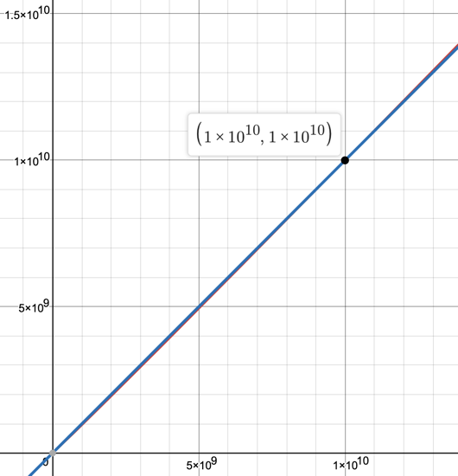

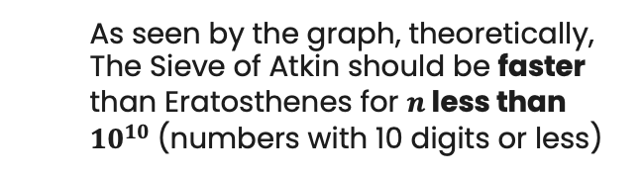
Results (Generating Algorithms)
07
Theoretical Values
Sieve of Eratosthenes: $Ο\left(nlog\left(logn\right)\right)$
Sieve of Atkin: $Ο(n)$
As seen by the graph, theoretically, The Sieve of Atkin should be faster than Eratosthenes for $n$less than ${10}^{10}$ (numbers with 10 digits or less)
Eratosthenes
Atkin

Slide 25
Experimental Values
Comparison of Data
Number of Digits | Eratosthenes | Atkin
2 | 989.97 | 328.61
4 | 14136.46 | 46712.24
6 | 3747951.7 | 4522752.1
>
<
<
The Sieve of Atkin has a faster running time than the Sieve of Eratosthenes when computing all prime numbers less than or equal to a number that has two digits
However, it has a slower running time when computing the method for four- and six- digit numbers

Slide 26
Comparison of Theoretical and Experimental Data
The experimental values do not follow the theoretical complexities formerly predicted
However, the collected values do follow the trend that the Sieve of Atkins is faster at computing smaller numbers while the Sieve of Eratosthenes is faster at computing inputs that are very large

Slide 27
Implementations (Testing Algorithms)
08
2. Prime Number Testing Algorithms
Given an input n, identifies if n is prime
Fermat’s Primality Test
The Rabin-Miller Primality Test
Primality Test: A test to determine if a given number is prime

Slide 28
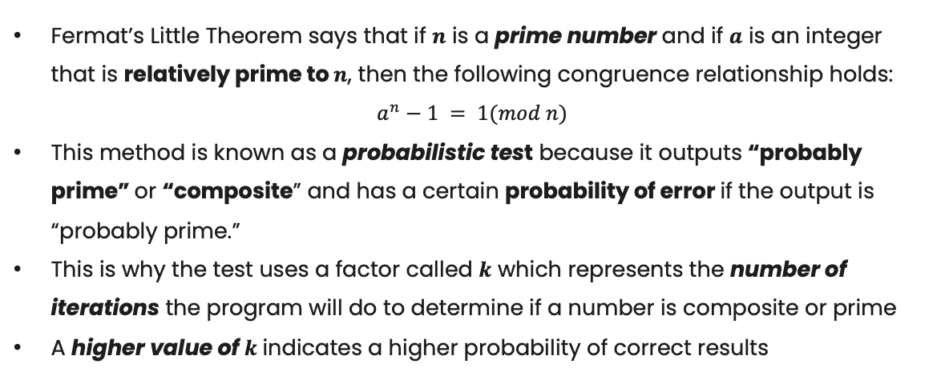
Fermat’s Primality Test
This method is a probabilistic test based on Fermat’s Little Theorem.
General Concepts
Fermat’s Little Theorem says that if $n$ is a prime number and if $a$ is an integer that is relatively prime to $n$, then the following congruence relationship holds:
$$a^{n}−1 = 1(mod n)$$
This method is known as a probabilistic test because it outputs “probably prime” or “composite” and has a certain probability of error if the output is “probably prime.”
This is why the test uses a factor called $k$ which represents the number of iterations the program will do to determine if a number is composite or prime
A higher value of $k$ indicates a higher probability of correct results

Slide 29
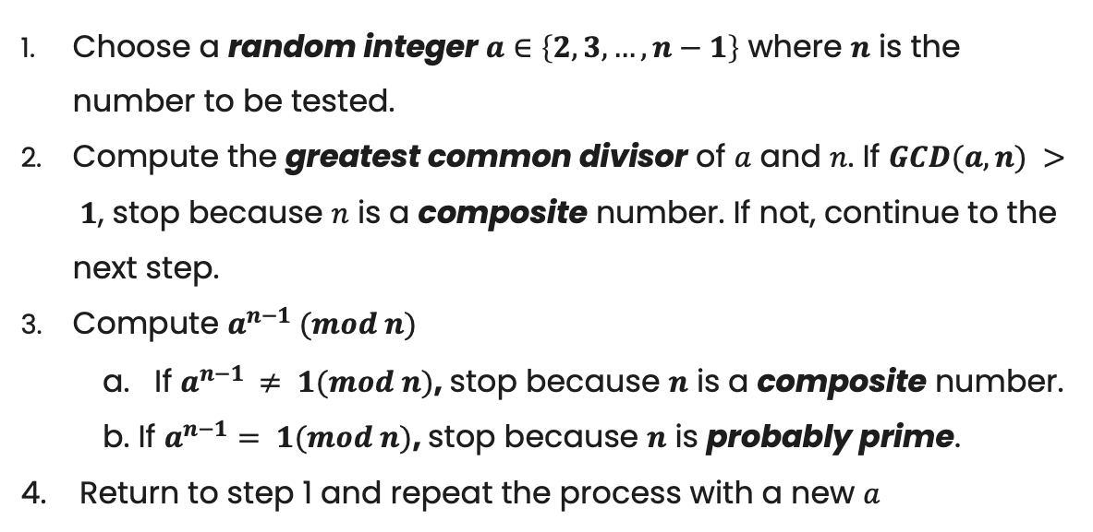
Fermat’s Primality Test(continued)
Steps
Choose a random integer $a∈\left\{2, 3, …, n−1\right\}$ where $n$ is the number to be tested.
Compute the greatest common divisor of $a$ and $n$. If $GCD(a, n) > 1$, stop because $n$ is a composite number. If not, continue to the next step.
Compute $a^{n−1} (mod n)$
a. If $a^{n−1 }≠ 1(mod n)$, stop because $n$ is a composite number.
b. If $a^{n−1}= 1(mod n)$, stop because $n$ is probably prime.
4. Return to step 1 and repeat the process with a new $a$
These steps are a modified version from Dan Ma (Ma, 2013)

Slide 30
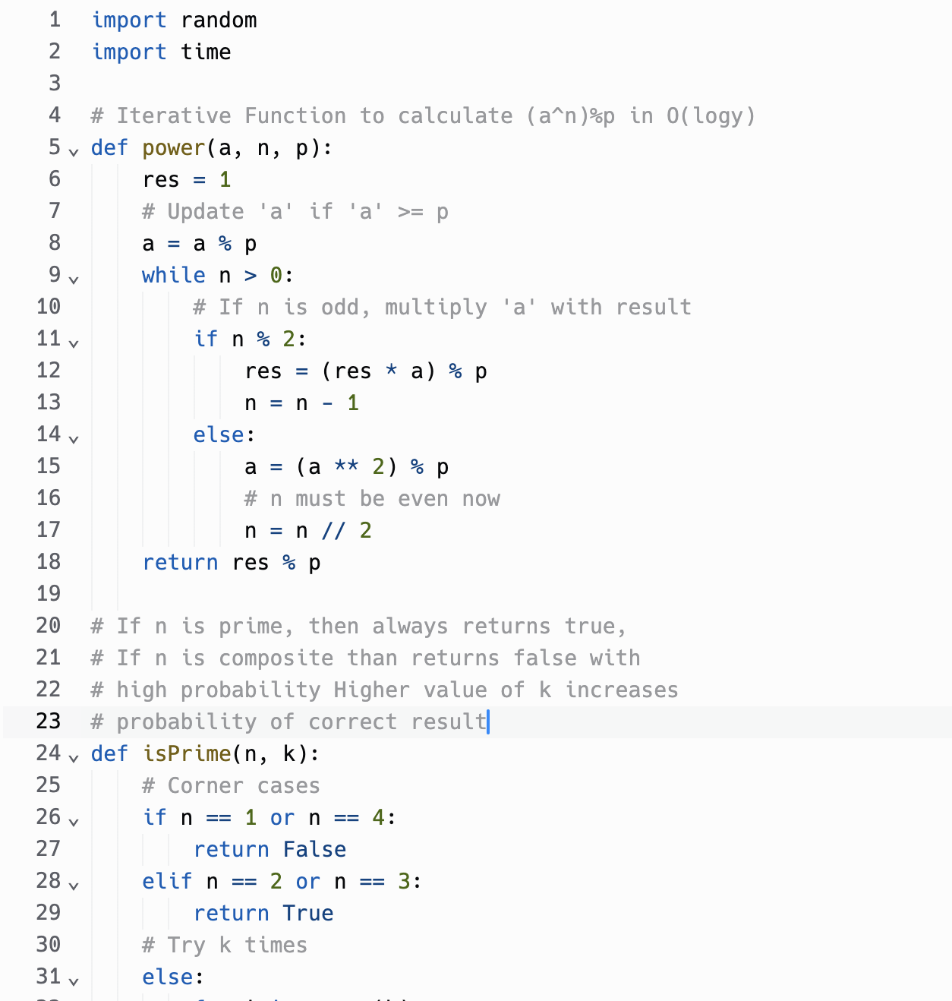
Fermat’s Primality Test(code)
This code is a modified version from GeeksforGeeks:
https://www.geeksforgeeks.org/fermat-method-of-primality-test/

Slide 31
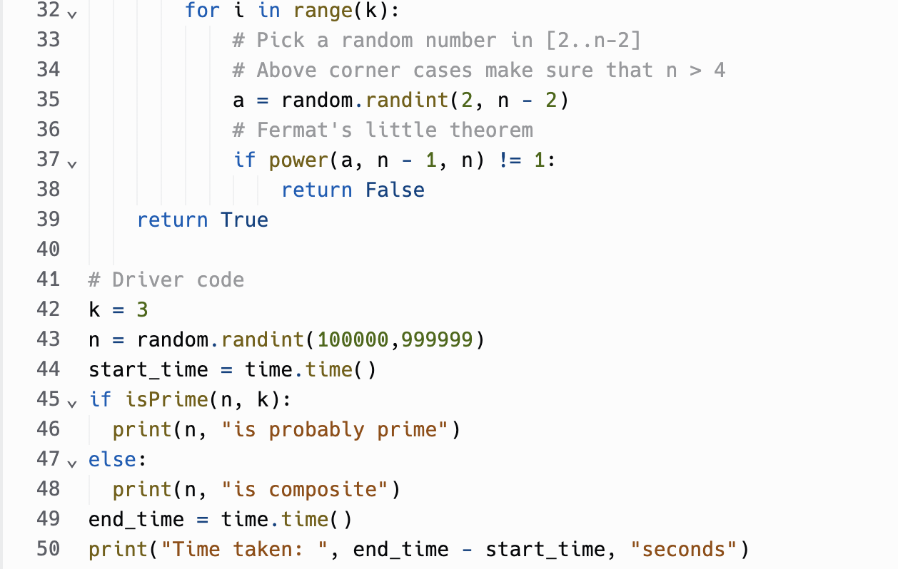

Fermat’s Primality Test(code)
By analyzing the number of primitive operations, the estimated time complexity is $Ο\left(klogn\right)$, where $k$ is the number of iterations

Slide 32
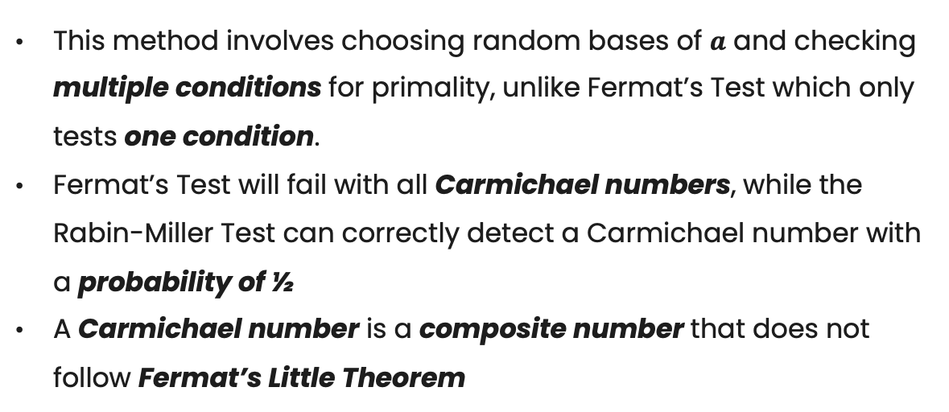
The Rabin-Miller Primality Test
This test is an extension of Fermat’s Primality Test, but tests for primality at a much higher probability.
General Concepts
This method involves choosing random bases of $a$ and checking multiple conditions for primality, unlike Fermat’s Test which only tests one condition.
Fermat’s Test will fail with all Carmichael numbers, while the Rabin-Miller Test can correctly detect a Carmichael number with a probability of ½
A Carmichael number is a composite number that does not follow Fermat’s Little Theorem
Notes:
Carmichael numbers are rare, with only 7 less than 10,000

Slide 33
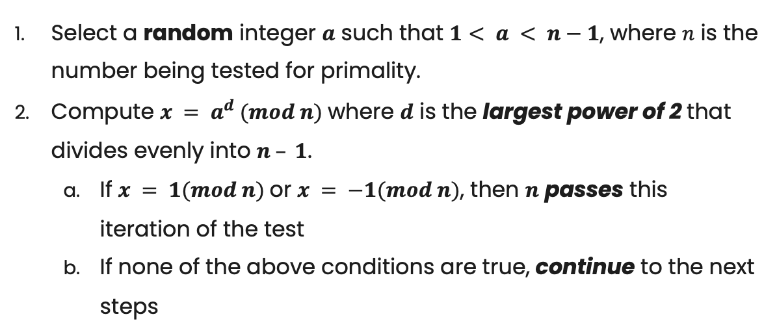
Rabin-Miller Primality Test(continued)
Steps
Select a random integer $a$ such that $1< a < n−1$, where $n$ is the number being tested for primality.
Compute $x = a^{d} (mod n)$where $d$ is the largest power of 2 that divides evenly into $n – 1$.
If $x = 1(mod n)$or $x = −1(mod n)$, then $n$ passes this iteration of the test
If none of the above conditions are true, continue to the next steps

Slide 34
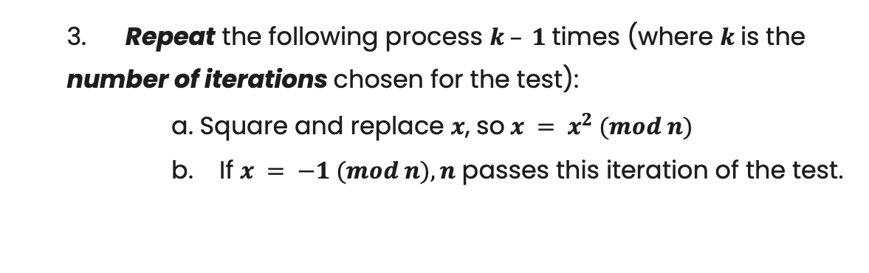
Rabin-Miller Primality Test(continued)
Steps (continued)
3. Repeat the following process $k – 1$times (where $k$is the number of iterations chosen for the test):
a. Square and replace $x$, so $x = x^{2} (mod n)$
b. If $x = −1 (mod n), n$ passes this iteration of the test.

Slide 35
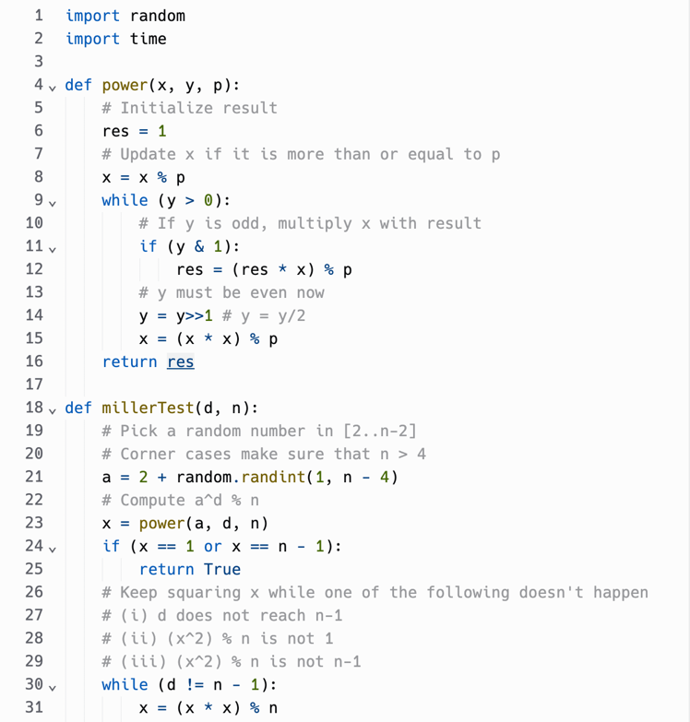
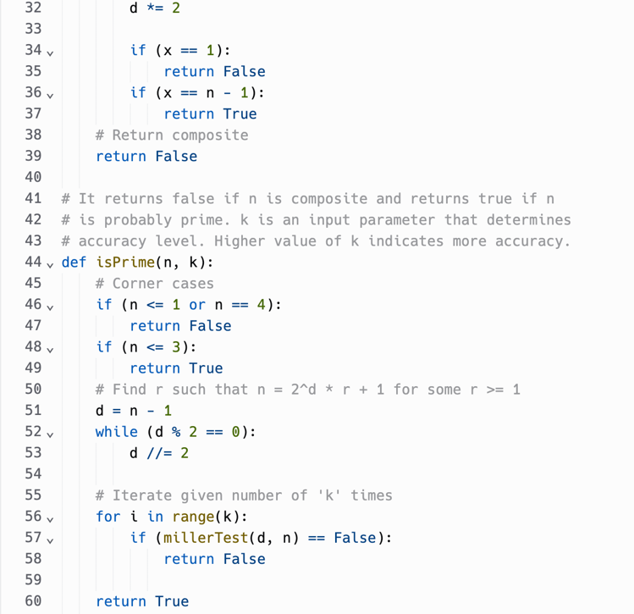
Rabin-Miller Primality Test(code)
This code is a modified version from GeeksforGeeks:
https://www.geeksforgeeks.org/primality-test-set-3-miller-rabin/

Slide 36
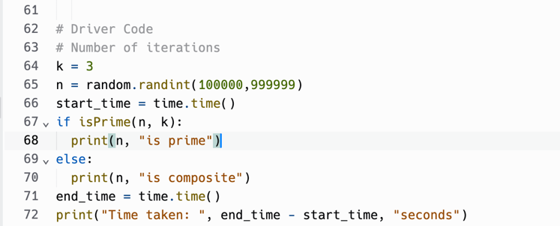
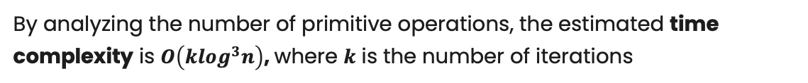
Rabin-Miller Primality Test(code)
By analyzing the number of primitive operations, the estimated time complexity is $Ο\left(klog^{3}n\right)$, where $k$ is the number of iterations

Slide 37
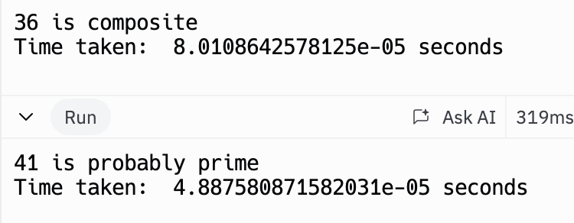
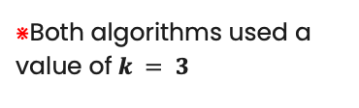
Data Collection (Testing Algorithms)
09
Test Cases: Three sets of test cases were generated to evaluate the performance of the prime generation and testing algorithms.
Test 1: Random inputs with 2 digits (10 to 99 inclusive)
Test 2: Random inputs with 4 digits (1,000 to 9.999 inclusive)
Test 3: Random inputs with 6 digits (100,000 to 999,999 inclusive)
Trials: Each test consisted of 10 trials, ensuring consistency and reliability in the data collection process.
Example Run:
$⋇$Both algorithms used a value of$k = 3$

Slide 38
Fermat’s Primality Test
Trial Number | 2 digits (μs) | 4 digits (μs) | 6 digits (μs)
1 | 66.3 | 70.8 | 78.4
2 | 56.3 | 67.0 | 69.8
3 | 38.9 | 93.7 | 359.1
4 | 50.3 | 84.6 | 183.3
5 6 7 8 9 | 63.9 44.3 44.6 156.9 858.8 | 79.2 55.1 47.9 76.8 83.9 | 87.3 82.7 406.5 93.0 75.6
10 | 55.3 | 69.6 | 105.4
Average | 143.56 | 72.86 | 154.11

Slide 39
Rabin-Miller Primality Test
Trial Number | 2 digits (μs) | 4 digits (μs) | 6 digits (μs)
1 | 97.5 | 58.7 | 78.9
2 | 64.4 | 48.9 | 77.5
3 | 68.2 | 78.4 | 196.2
4 | 62.0 | 80.8 | 50.3
5 6 7 8 9 | 55.8 78.2 46.3 59.4 78.8 | 104.0 43.6 68.0 45.1 105.4 | 90.6 76.3 79.9 191.5 2608.5
10 | 69.4 | 74.4 | 149.0
Average | 68 | 70.73 | 359.87

Slide 40
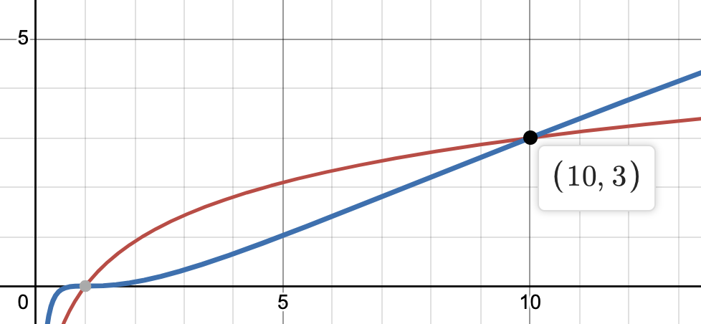

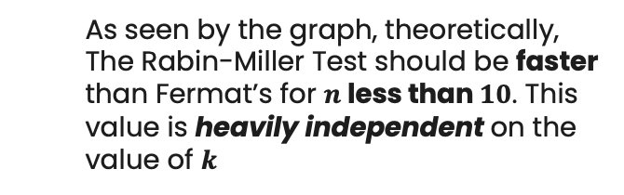
Results (Testing Algorithms)
10
Theoretical Values
Fermat’s Primality Test: $Ο\left(klogn\right)$
The Rabin-Miller Primality Test: $Ο(klog^{3}n)$
As seen by the graph, theoretically, The Rabin-Miller Test should be faster than Fermat’s for $n$less than $10$. This value is heavily independent on the value of $k$
Rabin-Miller
Fermat’s

Slide 41
Experimental Values
Comparison of Data
Number of Digits | Fermat | Rabin-Miller
2 | 143.56 | 68
4 | 72.86 | 70.73
6 | 154.11 | 359.87
>
>
<
The Rabin-Miller test has a faster running time than Fermat’s Test when the input is a number that has two or four digits
However, it has a slower running time when computing the method for six- digit numbers

Slide 42
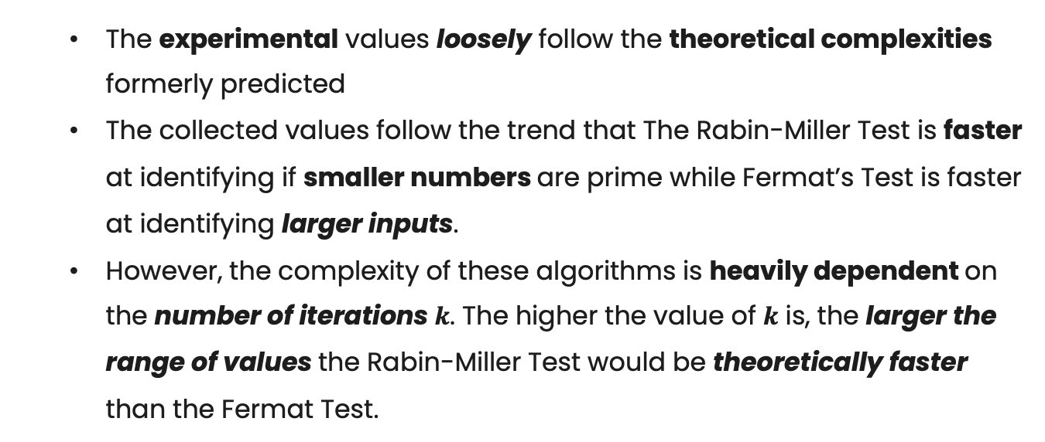
Comparison of Theoretical and Experimental Data
The experimental values loosely follow the theoretical complexities formerly predicted
The collected values follow the trend that The Rabin-Miller Test is faster at identifying if smaller numbers are prime while Fermat’s Test is faster at identifying larger inputs.
However, the complexity of these algorithms is heavily dependent on the number of iterations $k$. The higher the value of $k$ is, the larger the range of values the Rabin-Miller Test would be theoretically faster than the Fermat Test.

Slide 43
Discussion
11
Key Findings
Though the theoretical values did not exactly match the experimental values, we learned a few things:
The Sieve of Atkin was found to run faster for inputs with a smaller number of digits, but slower than the run time of the Sieve of Eratosthenes for inputs with more digits.
the Rabin-Miller Primality Test is faster for smaller inputs, while Fermat’s Primality Test is faster for larger inputs

Slide 44
Discussion (continued)
Limitations
There are many factors and limitations that could have contributed to the large variance between the actual and expected results:
Hardware and software environments
Amount of data able to be collected
Non-optimal implementations of the algorithms
The small values of k

Slide 45
Conclusion
12
Summary
In this project, I’ve achieved my goals and objectives of:
Implementing the Sieve of Eratosthenes and the Sieve of Atkin
Implementing Fermat’s Primality Test and the Rabin-Miller Primality Test
Measuring the execution times of the algorithms
Analyzed their time complexities
Visualized the collected data to demonstrate performance differences

Slide 46
Importance
Prime numbers play a big role in security systems, especially in cryptography
As seen from this project, these prime number generation and testing algorithms can be fairly complicated
The algorithms studied are still not seen as “efficient” due to the mathematical properties of prime numbers
Prime numbers will probably continue to be pivotal in cyber security until a more efficient algorithm is found (which is very unlikely)

Slide 47
Future Considerations
There are many ways this experiment can be modified to produce more accurate results:
Find a more stable compiler that does not rely on internet access
Collection of more data and larger input values
Testing with larger values of k
Using set test cases instead of randomly generated test cases
Estimating space complexity
Researching different algorithms (Sieve of Sundaram, Solovay-Strassen Primality Test)

Slide 48
References
13
GfG. (2022, November 14). Primality test: Set 3 (Miller–Rabin). GeeksforGeeks. https://www.geeksforgeeks.org/primality-test-set-3-miller-rabin/
GfG. (2023a, March 31). Sieve of atkin. GeeksforGeeks. https://www.geeksforgeeks.org/sieve-of-atkin/
GfG. (2023b, June 1). Fermat method of Primality Test. GeeksforGeeks. https://www.geeksforgeeks.org/fermat-method-of-primality-test/
GfG. (2024, March 6). Sieve of eratosthenes. GeeksforGeeks. https://www.geeksforgeeks.org/sieve-of-eratosthenes/
Kaur, K. (2021). Sieve of eratosthenes algorithm. Top Website Designers, Developers, Freelancers for Your Next Project. https://www.topcoder.com/thrive/articles/sieve-of-eratosthenes-algorithm
Ma, D. (2015, March 29). Using Fermat’s little theorem to test primality. Exploring Number Theory. https://exploringnumbertheory.wordpress.com/2013/08/10/using-fermats-little-theorem-to-test-primality/
Maier, A. (2021, August 16). Prime numbers and their importance to modern life. CodeCoda.com. https://codecoda.com/en/blog/entry/prime-numbers-and-the-importance-to-modern-life

Slide 49
Thanks!
Do you have any questions?
hdph78@umsystem.edu
The source code files for this project can be found at https://github.com/halleepham/CS404-MiniProject.git

